Slide 1
Pivot Animator

Slide 2
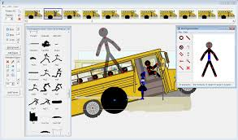
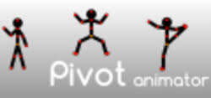
Pivot AnimAtor:
Pivot Animator is a freeware application.
That allows users to create stick-figure and sprite animations.
Save them in the animated GIF format for use on web pages and the AVI format.

Slide 3

Peter Bone CREATOR OF PIVOT ANIMATOR.

Slide 4
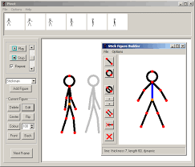
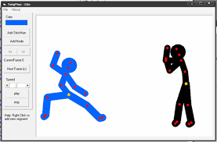
Pivot was created by Peter Bone using Delphi. The first version was started in around 2004.

Slide 5
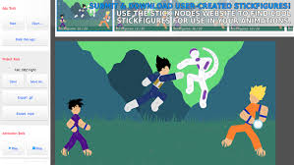
Pivot was created because his brother needed something user friendly for making stickman animations. The basic idea of Pivot was to make it possible to make a stickman animation by dragging the parts of the stickman while keeping the proportions of its parts constant. Pivot was the first software designed specifically for stick figure animation to use this mechanism.

Slide 6
Pivot will only run on Windows. However, you can use Boot Camp to run Pivot on a Mac with a recent version of OS X. You can run Pivot on Linux using the WINE emulator.

Slide 7
DIFFERENT VERSIONS OF PIVOT ANIMATOR 2.2,3.1,4.1 AND THE LATEST VERSION IS 4.2.6 RELEASED ON JUNE 28,2016.

Slide 8
THE END

